Slide 1
CLOUD NATIVE UNIVERSITY
How Kubernetes
Actually Ships
An Educator’s Guide to Core Releases, SIGs, and Staying Current
Mumshad Mannambeth & Michael Forrester
KodeKloud • KubeCon EU 2026 • Amsterdam
Notes:
MUMSHAD: So Michael and I have trained over a million students at KodeKloud. We've helped more people pass Kubernetes certifications than almost anyone. And you know what the number one message we get the week after someone passes their exam is? "I passed. Now what?" That's literally it. "Now what." So today we're going to answer that question. I'm going to play the guy who just passed his CKA -- because I remember exactly what that feels like -- and Michael is going to be the guide I wish I'd had. Ready? MICHAEL: Let's do it.

Slide 2
“
I just got my CKA. How long before what I
learned is out of date?
— Mumshad
Notes:
MUMSHAD: Okay so I passed my CKA. I studied hard. I know my stuff. How long before what I learned is out of date?

Slide 3
Kubernetes Release Cadence
3 releases/year • ~15-week cycles • 14 months patch support
Version | Codename | Released | Status
v1.32 | Penelope | Dec 11, 2024 | ❌ EOL Feb 28, 2026
v1.33 | Octarine | Apr 23, 2025 | ✅ Active support
v1.34 | Of Wind & Will | Aug 27, 2025 | ✅ Active support
v1.35 | Timbernetes | Dec 17, 2025 | ✅ Current
v1.36 | TBD | Apr 22, 2026 (target) | ⏳ Code freeze Mar 18
60
14 mo
ARCHIVED
v1.35 Enhancements
Patch Support
Ingress-NGINX
17 Stable • 19 Beta • 22 Alpha
per release
March 2026 — migrate to Gateway API
Notes:
MICHAEL: Honestly? Parts of it are already out of date. Kubernetes ships three releases a year on roughly 15-week cycles. v1.35, codenamed "Timbernetes," shipped December 17th. v1.36 is targeting April 22nd -- that's less than a month from now. Each release can deprecate APIs, graduate features, or change default behaviors. MUMSHAD: Wait -- so what I studied for my cert six months ago might already have deprecations I don't know about? MICHAEL: Exactly. Here's a real example: v1.32 -- end of life was February 28th. That's three weeks ago. If you passed your cert on v1.32, that version is already unsupported. And here's one that's going to affect a lot of people in this room: Ingress NGINX is being archived after March 2026. Gateway API is the replacement. If you learned Ingress for your cert, you need to learn Gateway API now. Your cert is a snapshot. The ecosystem is a moving target. MUMSHAD: So how do I track that? I can't re-study every four months. MICHAEL: You don't need to. You need a system. But first, let me show you how the machine works -- because once you understand the structure, you'll know exactly where to look.

Slide 4
“
Is CNCF in charge
of Kubernetes?
— Mumshad
Notes:
MUMSHAD: Okay, I always assumed CNCF runs Kubernetes. Is that right?

Slide 5
All 24 Kubernetes Special Interest Groups
SIGs own Kubernetes. They write the code. They manage the releases. They make the decisions.
API Machinery Kubernetes API server, libraries, tools
Contributor Experience New contributors, GitHub management
Release Release process, cadence, tooling
Apps Deployments, DaemonSets, StatefulSets, Jobs
Docs kubernetes.io documentation
Scalability Performance, scalability testing
Architecture KEP process, API review, conformance
etcd etcd datastore (newest SIG, Nov 2023)
Scheduling kube-scheduler, pod scheduling
Auth Authentication, authorization, security policy
Instrumentation Metrics, logging, tracing
Security Vulnerability response, security tooling
Autoscaling HPA, VPA, cluster autoscaler
K8s Infra Build/release infra, container registry
Storage CSI, persistent volumes, storage classes
CLI kubectl, kustomize CLI experience
Multicluster Multi-cluster tools and APIs
Testing Test infra, CI/CD, Prow, TestGrid
Cloud Provider Cloud provider integrations
Network Networking, services, DNS, Gateway API
UI Kubernetes Dashboard
Cluster Lifecycle kubeadm, Cluster API, minikube, kind
Node kubelet, container runtime, pod lifecycle
Windows Windows container support
Steering Committee (7 elected members) handles governance. Delegates ALL technical authority to SIGs. | CNCF = Landlord (trademark, conformance, KubeCon). Can't tell K8s how to arrange its furniture.
Notes:
MICHAEL: No. And this is one of the most common misconceptions. CNCF is like a landlord. They own the building -- the trademark, conformance certification, KubeCon. But they can't tell the tenant how to arrange the furniture. Every technical decision in Kubernetes is made by SIGs -- Special Interest Groups. There are 24 of them. MUMSHAD: Twenty-four? MICHAEL: Twenty-four. SIG Network owns all the networking code. SIG Node owns the kubelet. SIG Release manages the release process. SIG Architecture runs API review and the KEP process. Each SIG has chairs, tech leads, and genuine authority over their domain. No central body approves every change -- the SIGs decide. MUMSHAD: So if I want to know what's changing in networking, I don't go to CNCF... MICHAEL: You go to SIG Network. Their Slack channel, their mailing list, their meetings. That's where the decisions are made.

Slide 6
Inside the SIGs: Subprojects
Core Subprojects
SIG Subprojects
github.com/kubernetes
github.com/kubernetes-sigs (~200 repos)
Ships in every Kubernetes release
kube-apiserver, kubelet, kubectl,
kube-scheduler, kube-controller-manager,
kube-proxy
Version = Kubernetes version (e.g. v1.35.1)
Official K8s, but release independently
Gateway API (v1.5.1, own GEP process)
Cluster API, Kustomize, external-dns,
metrics-server, kind, kueue
Own version, own release cadence, own CRDs
Working Groups are temporary, cross-SIG, own no code. They disband when their issue is resolved. (9 active)
Notes:
MICHAEL: But here's what most people miss: SIGs have subprojects. That's where specific work happens. Core subprojects live in github.com/kubernetes -- that's kube-apiserver, kubelet, kubectl. These ship in every release. SIG subprojects live in github.com/kubernetes-sigs -- roughly 200 repos. These are still official Kubernetes, but they release independently. Gateway API is a SIG Network subproject. It ships as CRDs, has its own version -- v1.5.1 -- its own GEP process, not KEPs. Cluster API, Kustomize, external-dns -- same pattern. Working Groups are temporary, cross-SIG, own no code. They disband when their issue is resolved. If you want to find who's in each body: github.com/kubernetes/steering, github.com/kubernetes/community/blob/master/sig-list.md.

Slide 7
“
So SIGs handle everything
across the whole cloud
native ecosystem too?
— Mumshad
Notes:
MUMSHAD: Wait -- I've also heard of TAGs. So SIGs handle everything across the whole cloud native ecosystem too?

Slide 8
Parallel Structures, Not the Same
 | KUBERNETES SIGs | CNCF TAGs
Code | Own and maintain code | Advisory only, own no code
Scope | Kubernetes only | All 200+ CNCF projects
Authority | Direct authority over subsystems | Recommendations to TOC
Reports to | K8s Steering Committee | CNCF TOC (11 members)
Count | 24 SIGs | 5 TAGs (restructured May 2025)
The 5 CNCF TAGs (May 2025 restructure)
TAG Developer Experience — databases, microservices, streaming, APIs
TAG Infrastructure — storage, networking, compute, service mesh, IaC
TAG Operational Resilience — observability, reliability, chaos engineering
TAG Security and Compliance — security hygiene, policy-as-code, supply chain
TAG Workloads Foundation — containers, runtimes, serverless, scheduling, CI/CD
Notes:
MICHAEL: Completely different. CNCF originally called their groups SIGs too, which confused everyone. So they renamed them TAGs -- Technical Advisory Groups. The key difference: SIGs own code. TAGs advise. SIGs report to the Kubernetes Steering Committee. TAGs report to the CNCF TOC. There are 5 TAGs now, restructured in May 2025 from the original 8. But TAGs do real work. TAG Security and Compliance has done 50+ security assessments of CNCF projects. They published the Cloud Native Security Whitepaper. Supply Chain Best Practices v2. And just this week at KubeCon -- they wrapped up the 2026 Security Slam. MUMSHAD: So SIGs build Kubernetes, TAGs advise on the ecosystem. Got it.

Slide 9
“
How does a feature actually
get into Kubernetes?
— Mumshad
Notes:
MUMSHAD: So how does a feature actually get into Kubernetes?

Slide 10
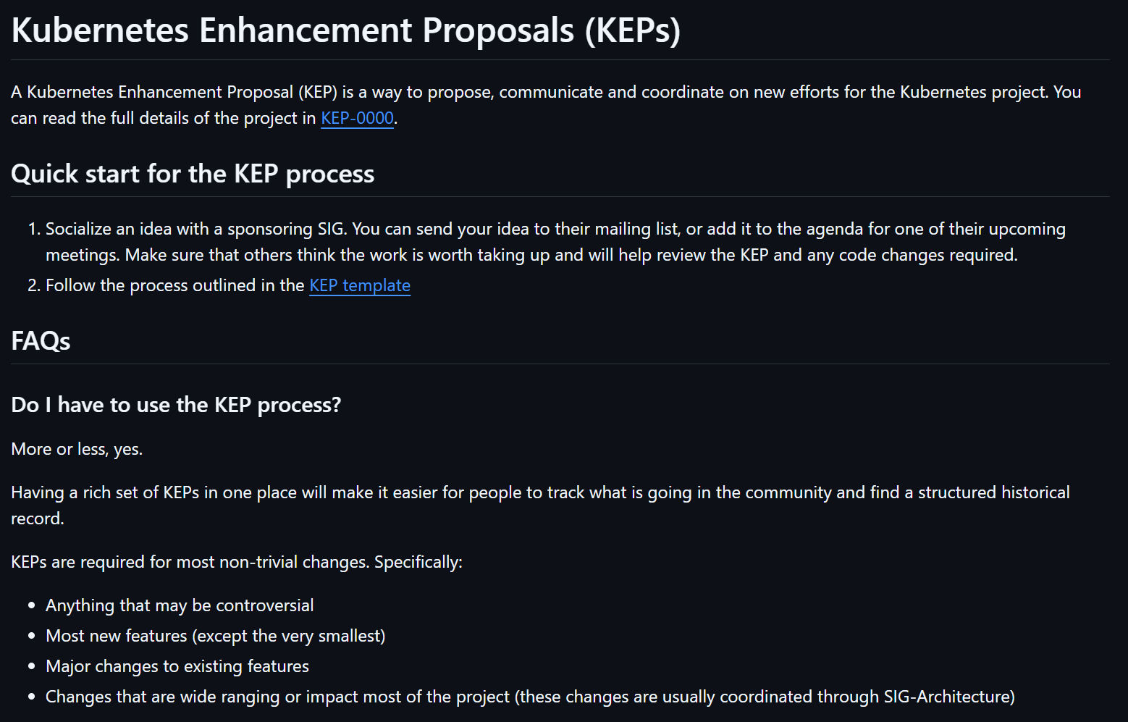
The KEP Pipeline
Kubernetes Enhancement Proposal — every significant change starts here
Notes:
MICHAEL: Through the KEP process -- Kubernetes Enhancement Proposal. Every significant change starts as a KEP in the kubernetes/enhancements repo. It goes through stages: Alpha means it exists but is off by default. Beta means it's on by default but might change. Stable means it's permanent. v1.35 had 60 enhancements: 17 went Stable, 19 graduated to Beta, 22 entered Alpha. That's the pipeline in action. Here's the actionable part: every KEP lives at a predictable URL. The path is keps/sig-{name}/{number}-{description}. And there's a shortcut: kep.k8s.io/{number} takes you straight there. So if someone mentions KEP-1287, you type kep.k8s.io/1287 and you're looking at the full proposal. MUMSHAD: Can you show me what that looks like for a real feature? MICHAEL: Let's do it.

Slide 11
The KEP Pipeline
Kubernetes Enhancement Proposal — every significant change starts here
ALPHA
BETA
STABLE (GA)
→
→
Feature gate OFF
by default.
Early adopters test.
Feature gate ON
by default.
Broader testing.
Feature gate locked.
Permanent.
Ships to everyone.
v1.35 “Timbernetes”: 60 enhancements — 17 Stable • 19 Beta • 22 Alpha
KEP URL pattern: keps/sig-{name}/{number}-{description} Shortcut: kep.k8s.io/{number}
Searchable release notes: relnotes.k8s.io https://github.com/kubernetes/enhancements/blob/master/keps/README.md - Kubernetes Enhancement Process
Notes:
MICHAEL: Through the KEP process -- Kubernetes Enhancement Proposal. Every significant change starts as a KEP in the kubernetes/enhancements repo. It goes through stages: Alpha means it exists but is off by default. Beta means it's on by default but might change. Stable means it's permanent. v1.35 had 60 enhancements: 17 went Stable, 19 graduated to Beta, 22 entered Alpha. That's the pipeline in action. Here's the actionable part: every KEP lives at a predictable URL. The path is keps/sig-{name}/{number}-{description}. And there's a shortcut: kep.k8s.io/{number} takes you straight there. So if someone mentions KEP-1287, you type kep.k8s.io/1287 and you're looking at the full proposal. MUMSHAD: Can you show me what that looks like for a real feature? MICHAEL: Let's do it.

Slide 12
“
I heard about In-Place
Pod Resize. Where did
it come from?
— Mumshad
Notes:
MUMSHAD: I heard about In-Place Pod Resize. Where did it come from?

Slide 13
Trace a Feature: KEP-1287
In-Place Pod Resize — change CPU/memory without restarting the pod
1
2
3
4
Proposed
Alpha in v1.27
Beta in v1.33
GA in v1.35
SIG Node created KEP under
keps/sig-node/1287-in-place-
update-pod-resources/
Feature gate
InPlacePodVerticalScaling
OFF by default
Feature gate ON by default.
Broader testing.
Feature gate locked.
Permanent. Shipped Dec 2025.
2023
Apr 2025
Dec 2025
8 versions. ~3 years from proposal to stable. That's normal.
The kep.yaml file in the repo tracks every stage transition. |
kep.k8s.io/1287
Notes:
MICHAEL: In-Place Pod Resize -- KEP-1287. This lets you change a pod's CPU and memory without restarting it. Here's how it traveled through the system: Step 1: Someone in SIG Node proposed it. The KEP was created under keps/sig-node/1287-in-place-update-pod-resources/. Step 2: It entered Alpha in v1.27. Feature gate InPlacePodVerticalScaling, off by default. Early adopters could test it. Step 3: It graduated to Beta in v1.33. Feature gate on by default. Broader testing. Step 4: It went GA -- Generally Available -- in v1.35, December 2025. Feature gate locked. It's permanent. That's 8 versions and roughly 3 years from proposal to stable. That's normal. The kep.yaml file in the repo tracks every stage transition. MUMSHAD: So if I want to know what's coming, I watch the enhancements repo? MICHAEL: Exactly. And relnotes.k8s.io gives you a searchable view of every release note.

Slide 14
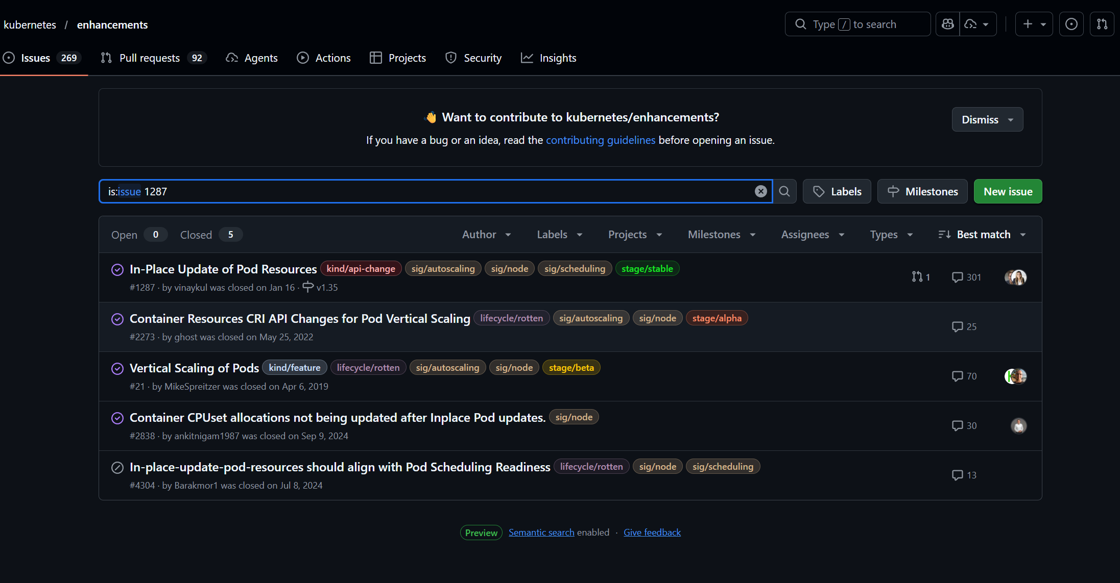
Trace a Feature: KEP-1287
Notes:
MICHAEL: In-Place Pod Resize -- KEP-1287. This lets you change a pod's CPU and memory without restarting it. Here's how it traveled through the system: Step 1: Someone in SIG Node proposed it. The KEP was created under keps/sig-node/1287-in-place-update-pod-resources/. Step 2: It entered Alpha in v1.27. Feature gate InPlacePodVerticalScaling, off by default. Early adopters could test it. Step 3: It graduated to Beta in v1.33. Feature gate on by default. Broader testing. Step 4: It went GA -- Generally Available -- in v1.35, December 2025. Feature gate locked. It's permanent. That's 8 versions and roughly 3 years from proposal to stable. That's normal. The kep.yaml file in the repo tracks every stage transition. MUMSHAD: So if I want to know what's coming, I watch the enhancements repo? MICHAEL: Exactly. And relnotes.k8s.io gives you a searchable view of every release note.

Slide 15
“
I found a bug in
Kubernetes. How do I
even report that?
— Mumshad
Notes:
MUMSHAD: Okay, different question. I found a bug in Kubernetes. How do I even report that?

Slide 16
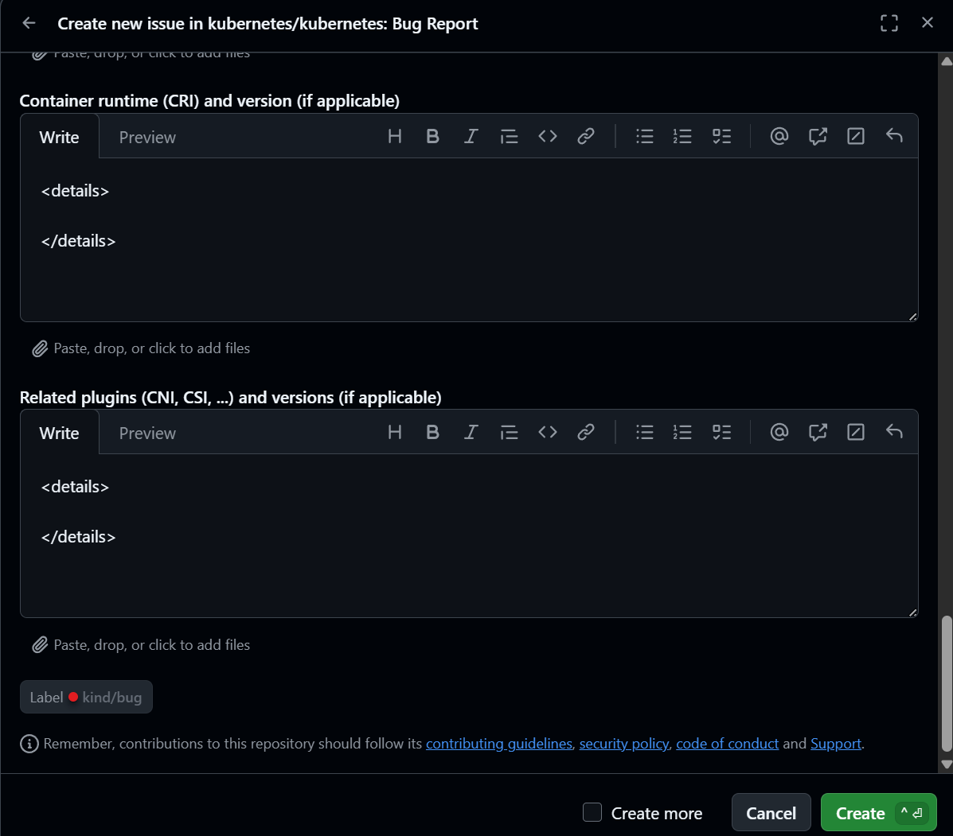
File a Bug: 4 Steps
1
Open an issue at github.com/kubernetes/kubernetes
Use the bug report template
2
Prow bot asks you to categorize.
Use bot commands (see right)
3
SIG that owns the area triages
and prioritizes it
4
If it's a SECURITY vulnerability:
DO NOT open a public issue.
Email security@kubernetes.io
⚠ SECURITY VULNERABILITIES: Email security@kubernetes.io — do NOT open a public issue. The Security Response Committee handles these privately.
Notes:
MICHAEL: Four steps. First: go to github.com/kubernetes/kubernetes and open an issue. Use the bug report template. Second: a Prow bot will ask you to categorize it. The key commands: /sig node -- assigns it to SIG Node. /triage accepted -- confirms it's a real issue. /assign @username -- claims it. /lgtm and /approve -- for the eventual fix. Full reference at go.k8s.io/bot-commands. Third: once it's triaged, the SIG that owns it will prioritize it. Fourth -- and this is critical -- if it's a security vulnerability, do NOT open a public issue. Email security@kubernetes.io. The Security Response Committee handles those privately. MUMSHAD: Even bug reporting is structured. Everything goes through the SIGs.

Slide 17
“
I subscribed to KubeWeekly
while studying. Am I good?
— Mumshad
Notes:
MUMSHAD: While I was studying, I subscribed to KubeWeekly. I haven't seen one in months. Am I good?

Slide 18
The Information Landscape Broke in 2025
DEAD
KubeWeekly
Final issue #434, May 2025
SURVIVED
Kubernetes Slack
Salesforce nearly killed free tier Jun 2025. Reversed last minute. 200K+ members.
UNCERTAIN
Kubernetes Podcast
Last episode #264, Dec 22 2025. Appears silently ended.
OFFICIAL
Bluesky @kubernetes.io
v1.33 blog directed users here. Listed before X on kubernetes.io/community.
ACTIVE
LWKD (lwkd.info)
Weekly digest of code changes. Your #1 staying-current source.
NEW
Wisdom of the Cloud
CNCF monthly newsletter. Replaced KubeWeekly.
ACTIVE
kubernetes-security-announce
Every CVE lands here first. Non-negotiable.
Notes:
MICHAEL: You're not. KubeWeekly published its last issue -- number 434 -- in May 2025. It's dead. MUMSHAD: My newsletter died and nobody sent me a memo. MICHAEL: And it gets worse. The Kubernetes Slack nearly migrated to Discord in June. Salesforce was going to kill the free enterprise tier. They reversed course at the last minute. But the near-death experience spooked the community. Meanwhile, Bluesky is now an official Kubernetes social channel -- the v1.33 release blog explicitly told people to follow @kubernetes.io on Bluesky. So the information landscape broke and reassembled in 2025. If you're using the same bookmarks from when you studied for your cert, half of them are stale. MUMSHAD: So what do I actually subscribe to now?

Slide 19
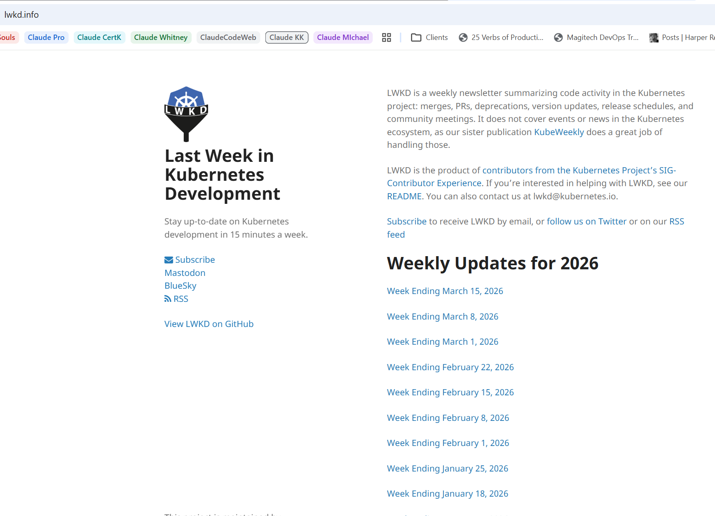
The Information Landscape Broke in 2025
Notes:
MICHAEL: You're not. KubeWeekly published its last issue -- number 434 -- in May 2025. It's dead. MUMSHAD: My newsletter died and nobody sent me a memo. MICHAEL: And it gets worse. The Kubernetes Slack nearly migrated to Discord in June. Salesforce was going to kill the free enterprise tier. They reversed course at the last minute. But the near-death experience spooked the community. Meanwhile, Bluesky is now an official Kubernetes social channel -- the v1.33 release blog explicitly told people to follow @kubernetes.io on Bluesky. So the information landscape broke and reassembled in 2025. If you're using the same bookmarks from when you studied for your cert, half of them are stale. MUMSHAD: So what do I actually subscribe to now?

Slide 20
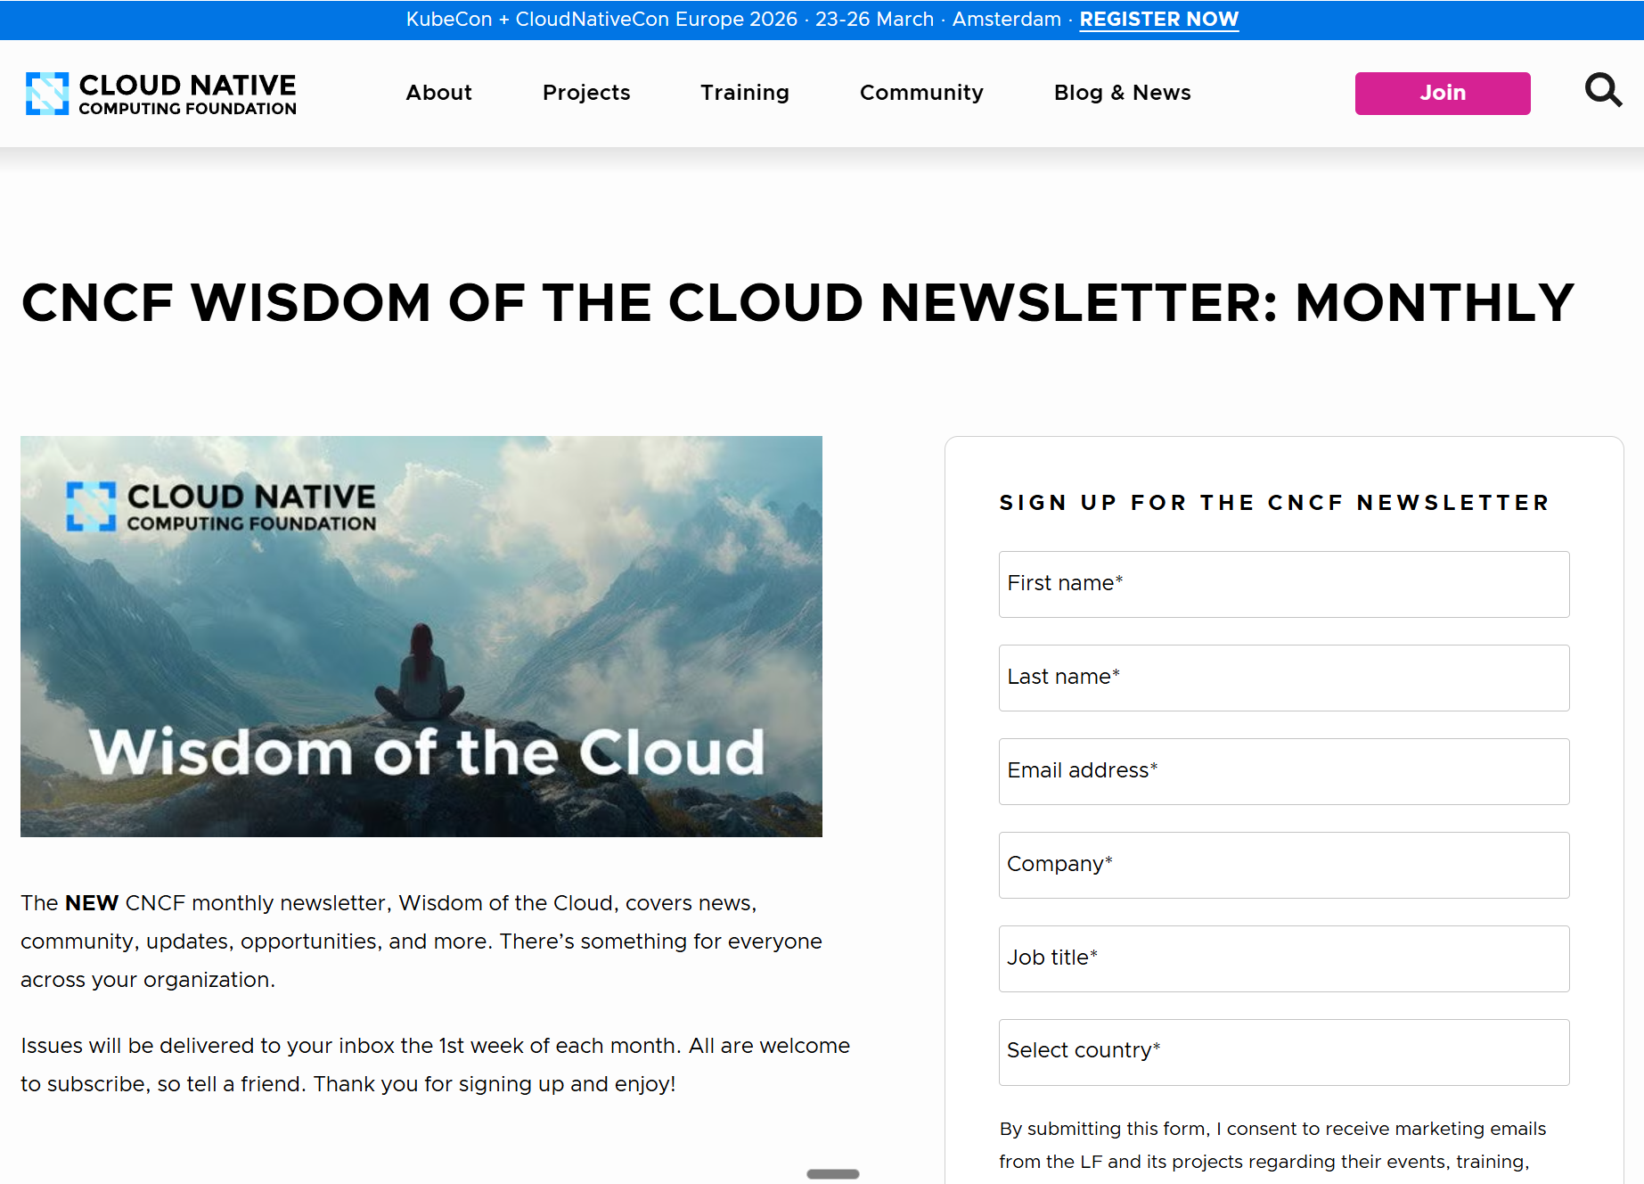
The Information Landscape Broke in 2025
Notes:
MICHAEL: You're not. KubeWeekly published its last issue -- number 434 -- in May 2025. It's dead. MUMSHAD: My newsletter died and nobody sent me a memo. MICHAEL: And it gets worse. The Kubernetes Slack nearly migrated to Discord in June. Salesforce was going to kill the free enterprise tier. They reversed course at the last minute. But the near-death experience spooked the community. Meanwhile, Bluesky is now an official Kubernetes social channel -- the v1.33 release blog explicitly told people to follow @kubernetes.io on Bluesky. So the information landscape broke and reassembled in 2025. If you're using the same bookmarks from when you studied for your cert, half of them are stale. MUMSHAD: So what do I actually subscribe to now?

Slide 21
“
I’m overwhelmed. What do
I actually need?
— Mumshad
Notes:
MUMSHAD: I'm overwhelmed. What do I actually need?

Slide 22
The Non-Negotiable Five
Subscribe once. Zero time until something fires.
1
kubernetes-security-announce
groups.google.com/g/kubernetes-security-announce
Every CVE lands here first
2
LWKD
lwkd.info
Weekly digest of code changes and deprecations
3
Kubernetes blog RSS
kubernetes.io/blog
Release announcements, deprecation notices
4
GitHub Releases Only watch
github.com/kubernetes/kubernetes
One notification per release
5
Official CVE JSON feed
k8s.io/docs/reference/issues-security/official-cve-feed/
Machine-readable feed from Security Response Committee
Weekly: 20 min reading LWKD + blog scan Monthly: Wisdom of the Cloud newsletter Ongoing: Join your SIG's Slack channel
Notes:
MICHAEL: Five things. Non-negotiable. 1. kubernetes-security-announce mailing list. Every CVE lands here first. 2. LWKD -- Last Week in Kubernetes Development. Weekly digest of what changed in the codebase. 3. Kubernetes blog RSS feed. Release announcements, deprecation notices. 4. GitHub "Releases Only" watch on kubernetes/kubernetes. One notification per release. 5. The official CVE JSON feed for automated monitoring. That's your safety net. Takes zero time until something fires. Then weekly: 20 minutes reading LWKD and scanning the blog. Monthly: check the "Wisdom of the Cloud" newsletter that replaced KubeWeekly. And join the Slack channel for whatever SIG is most relevant to your work. MUMSHAD: That's it? Five subscriptions and 20 minutes a week? MICHAEL: That's the system. And if you want to go deeper...

Slide 23
“
I want to go deeper.
How do I start
contributing?
— Mumshad
Notes:
MUMSHAD: Actually, yeah. I want to go deeper. How do I start contributing?

Slide 24
Start Contributing: 5 Steps
1
Join kubernetes.slack.com
Find #kubernetes-new-contributors
2
Attend a SIG Meet & Greet at KubeCon
Check kccnceu2026.sched.com for day/room or https://x.com/kubernetesio/status/2028636693234962767
3
Pick a SIG. Find their good-first-issue label on GitHub.
Every SIG maintains these.
4
Attend the New Contributor Orientation
Also happening this week at KubeCon
5
Apply for the Release Team Shadow program
Shadow a release role for one cycle
Get on Slack and ask if uncertain. Slack.cncf.io
Notes:
MICHAEL: Five steps: 1. Join kubernetes.slack.com and find #kubernetes-new-contributors. 2. Go to the SIG Meet & Greet -- check your KubeCon app, it's usually a lunch session in the Project Pavilion. You're literally surrounded by maintainers this week. 3. Pick a SIG. Find their good-first-issue label on GitHub. Every SIG maintains these. 4. Attend the New Contributor Orientation -- also happening this week. 5. For a deeper commitment, apply for the Release Team Shadow program. You'll shadow a release role for one cycle and learn the entire process. And while you're here, look for Josh Berkus -- Red Hat's Kubernetes Community Architect, SIG ContribEx. He's the person who connects newcomers to the right SIGs. MUMSHAD: So there's no excuse. The path exists, the people are here, and the structure is documented. MICHAEL: Zero excuses.

Slide 25
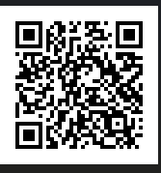
Scan This. Everything’s In The Repo.
1. Kubernetes ships 3x/year. Your cert is a snapshot.
[QR CODE]
2. SIGs own everything. CNCF is the landlord, not the architect.
3. TAGs advise across the CNCF ecosystem. SIGs build Kubernetes.
4. Five subscriptions and 20 minutes a week keeps you current.
github.com/kodekloudhub/k8s-staying-current
5. The contribution path is documented and the people are here this week.
Mumshad Mannambeth & Michael Forrester • KodeKloud
Notes:
MUMSHAD: Alright, let's land this. Everything we just covered is in this repo. The governance structure, the channel list, the KEP trace walkthrough, the contribution guide, the Non-Negotiable Five -- it's all there. Five things to remember: 1. Kubernetes ships 3x/year. Your cert is a snapshot. 2. SIGs own everything. CNCF is the landlord, not the architect. 3. TAGs advise across the ecosystem. SIGs build Kubernetes. 4. Five subscriptions and 20 minutes a week keeps you current. 5. The contribution path is documented and the people are here this week. Scan the code. Got it? Good.

